Slide 1

MCP in Action Powering Single & Multi-Agent Systems with LangChain.js

Slide 2


Who are we?
Wassim Chegham Senior Developer Advocate
Microsoft​
Yohan Lasorsa​ Principal Developer Advocate
Microsoft​

Slide 3
MCP in Action (Short) Introduction to MCP

Slide 4
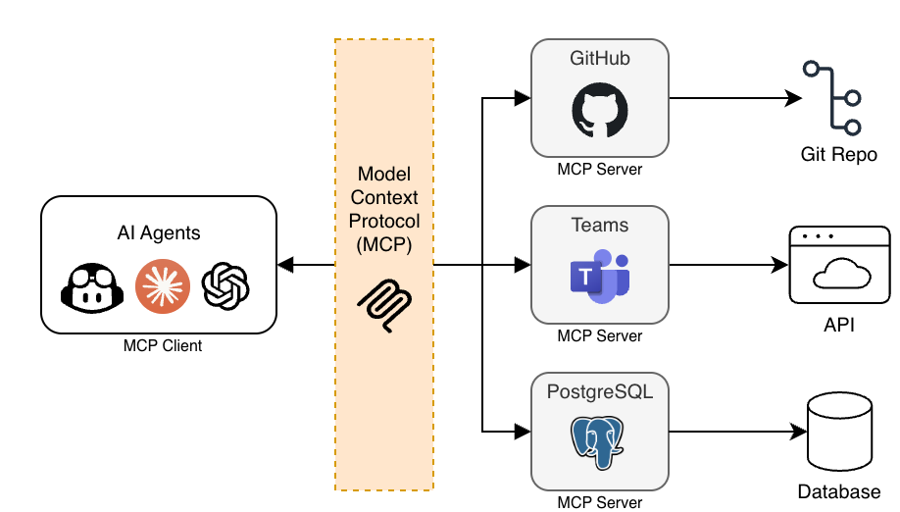
What is MCP?

Slide 5
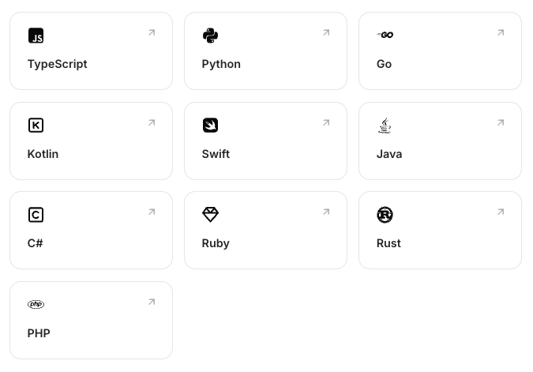


Using MCP
Client and server SDKs
Transports
stdio → local servers
Streamable HTTP → remote servers

Slide 6
MCP Features
Server
Tools
Resources
Prompts
Client
Roots
Elicitation
Sampling

Slide 7
MCP Security
Uses OAuth 2.1 Authorization Framework
Secures access to sensitive resources and operations exposed by MCP servers.
Read official docs for code samples https://modelcontextprotocol.io/docs/tutorials/security/authorization

Slide 8
Demo MCP Server “Hello World”

Slide 9
Demo Single Agent system with LangChain.js

Slide 10
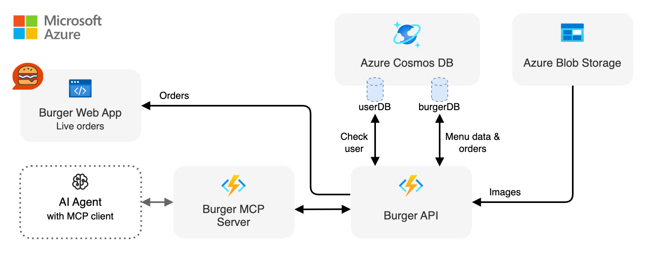
High level architecture

Slide 11
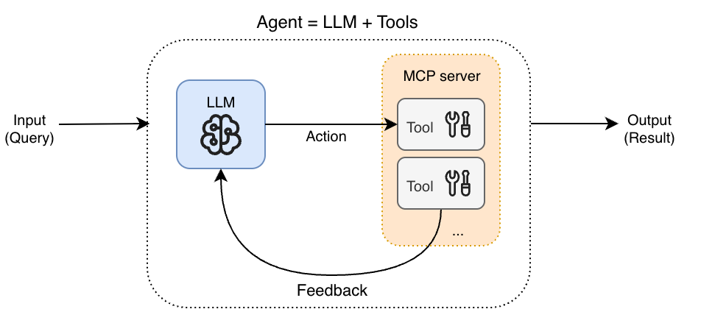
Simple agentic workflow

Slide 12
Overview: Burger Agent with MCP
Components: Burger API, MCP server, Agent API, Web Apps
Security: auth handled by Burger API
Scaling: stateless component + serverless hosting

Slide 13
Demo Multi-Agent Orchestration with LangChain.js

Slide 14
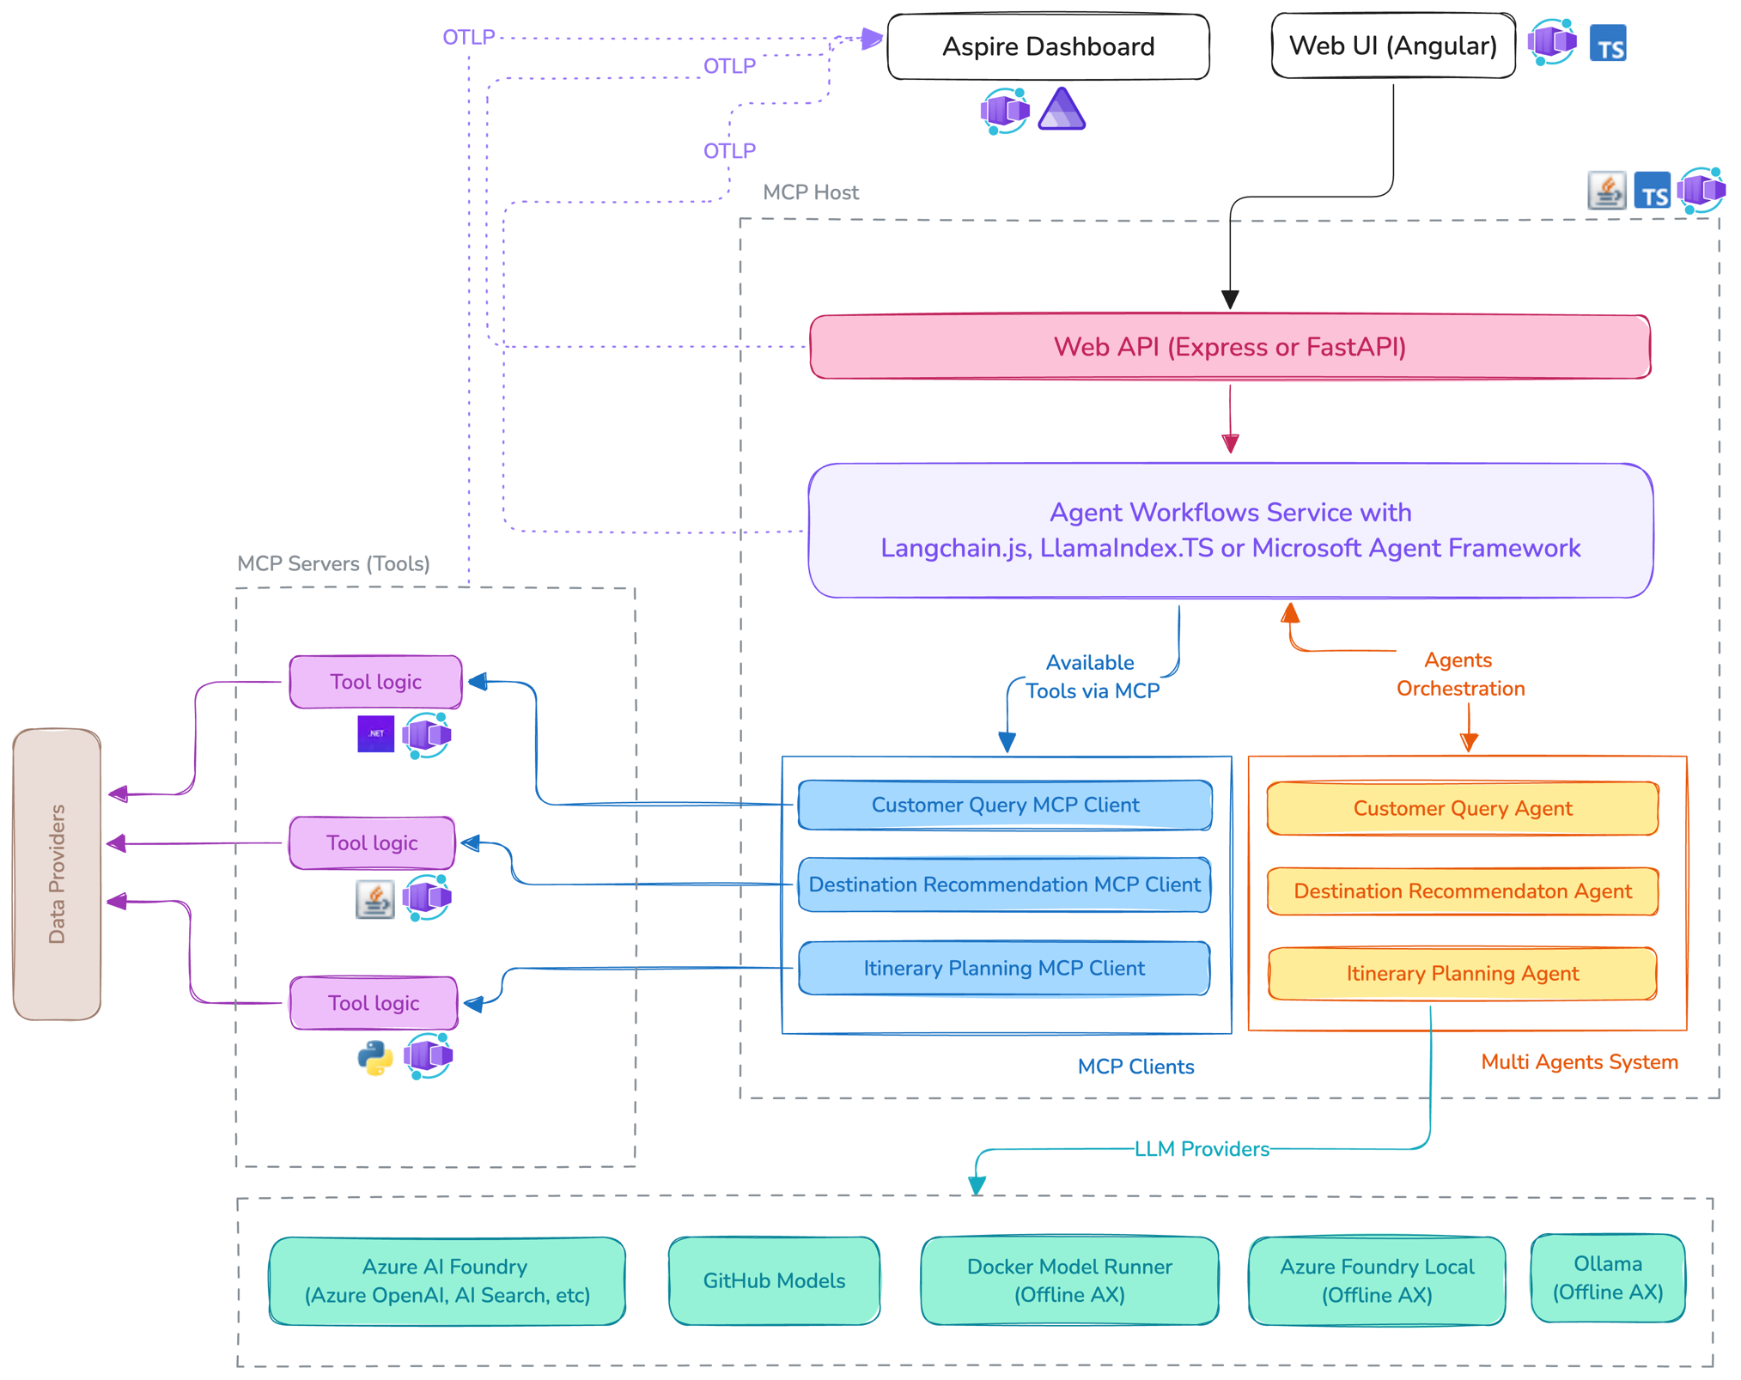
Real World Architecture Demo

Slide 15
Why Multi-Agent systems?
MAS is a system composed of multiple autonomous and specialized agents that interact together in shared environment to achieve a common objective.
MAS are better suited for complex business process.
DeepAgents and SubAgents are great for controlling context.

Slide 16
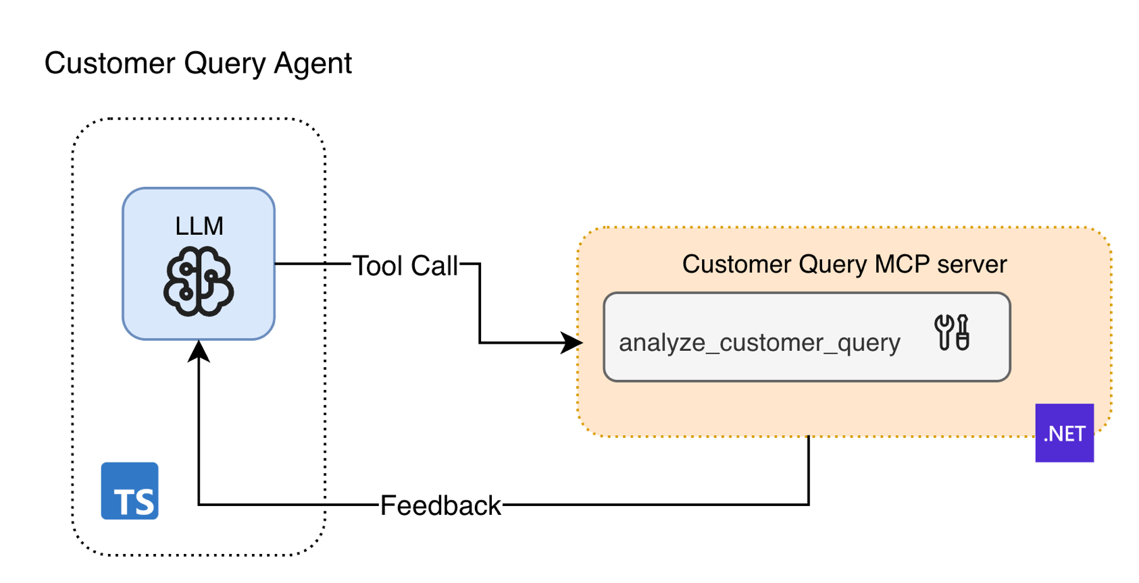
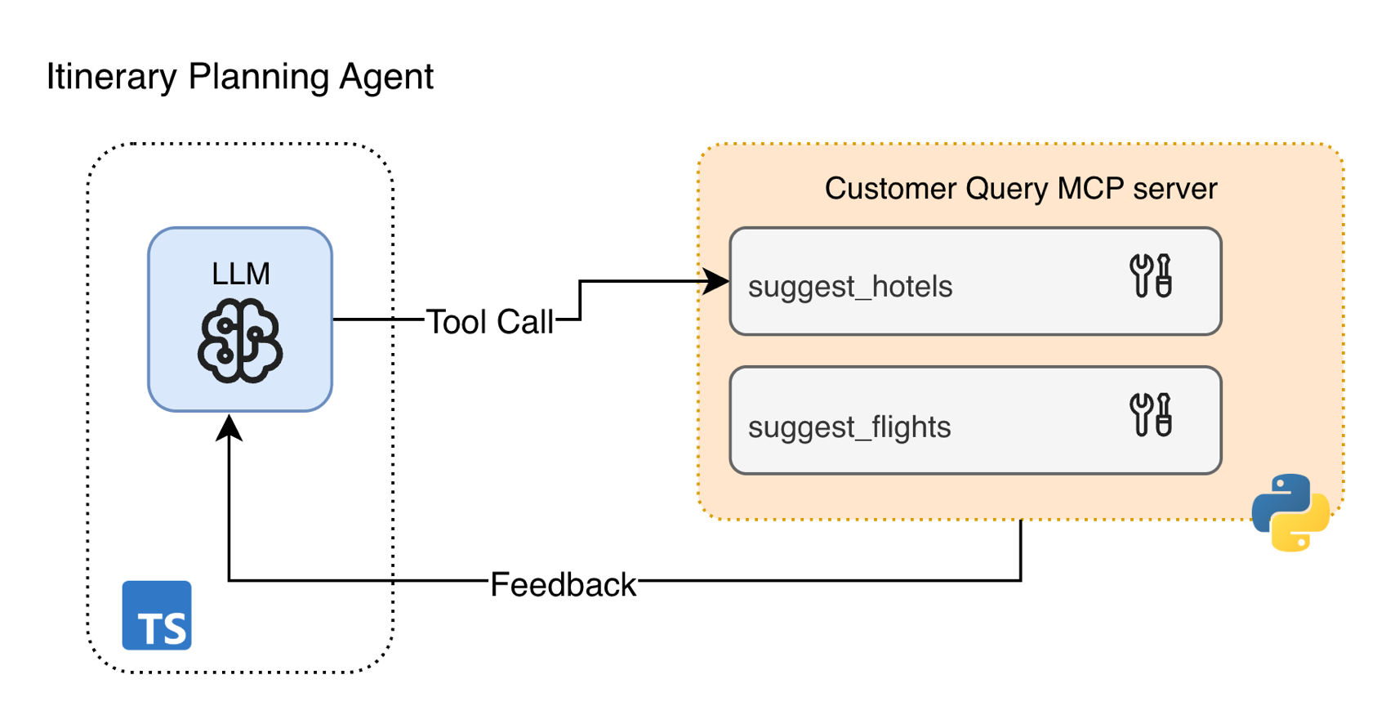
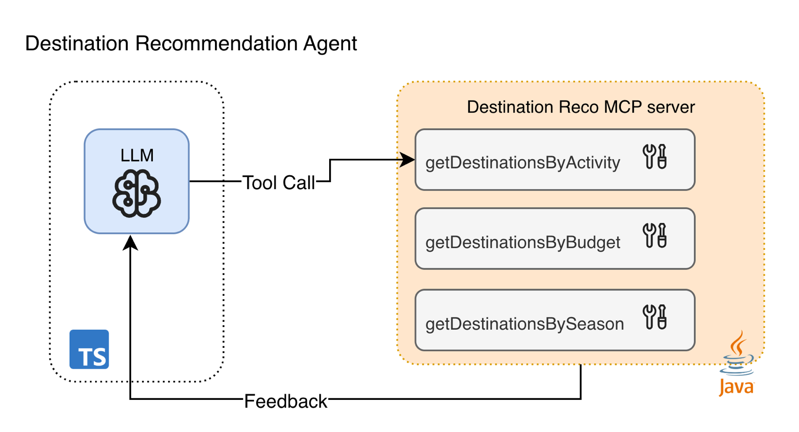
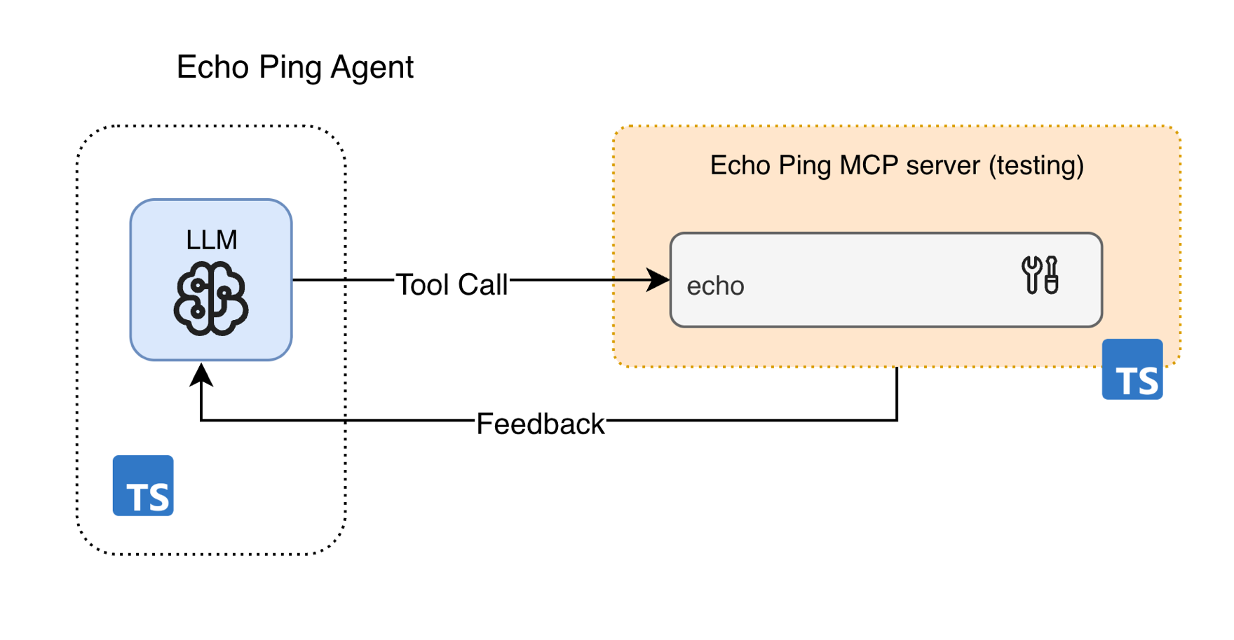
MCP servers & multi-language support

Slide 17
Security Considerations
Level 0: Authentication with JWT (see demo)
Level 1: Authorization
Level 2: OAuth 2.1 – MCP recommendations

Slide 18
Recap’ Powering Single & Multi-Agent Systems with LangChain.js
Notes:
[at: 40min]
WASSIM:
So, let's bring it all together.

Slide 19
Recap’: Agentic Systems with LangChain.js
MCP
Allow agents to interact with your environment
Single Agent
Simpler and more predictable, best for contained domains
Multi-Agent
More performant for complex, dynamic domains
Use createAgent()
Use deepagents or langgraph-supervisor

Slide 20

Thank you!
Any question? Join us on
Microsoft Foundry Discord
aka.ms/oss-ai-summit

